Slide 1
Object Detection
崑山科技大學資工所
深度學習Deep Learning課程
報告學生：薛博仁
學 號：4050C042
指導老師：龍大大

Slide 2
程式碼範例

Slide 3
I、Import
import numpy as np
import os
import six.moves.urllib as urllib
用來處理網路請求和操作url
import sys
import tarfile
tarfile是處理tar壓縮的
import tensorflow as tf
import zipfile
zipfile是處理zip壓縮的

Slide 4
I、Import
from collections import defaultdict
defaultdict對於我們調用一個不存在的key值，他會先建立一個default值給我們，而這個default值必須由一個可呼叫的函數產生，在我們初始化一個defaultdict時，必須先指定一個產生default值的函數
from io import StringIO
在記憶體中讀寫str
from matplotlib import pyplot as plt
視覺化工具
from PIL import Image
影像處理工具
from IPython.display import display
數學公式編輯

Slide 5
I、Import
from object_detection.utils import ops as utils_ops
from object_detection.utils import label_map_util
讓訓練的標籤與實際標籤對應
from object_detection.utils import visualization_utils as vis_util
資料可視化

Slide 6
II、Loader
def load_model(model_name):
base_url = 'http://download.tensorflow.org/models/object_detection/'
model_file = model_name + '.tar.gz'
model_dir = tf.keras.utils.get_file(
fname=model_name,
origin=base_url + model_file,
untar=True)
model_dir = pathlib.Path(model_dir)/"saved_model"
model = tf.saved_model.load(str(model_dir))
model = model.signatures['serving_default']
return model

Slide 7
III、Detection
#載入檢測的模型
model_name = 'ssd_mobilenet_v1_coco_2017_11_17'
detection_model = load_model(model_name)
#檢查unit8類型的三色圖像:
print(detection_model.inputs)
#輸出
detection_model.output_dtypes
{'detection_boxes': tf.float32, 'detection_classes': tf.float32, 'detection_scores': tf.float32, 'num_detections': tf.float32}
detection_model.output_shapes
{'detection_boxes': TensorShape([None, 100, 4]), 'detection_classes': TensorShape([None, 100]), 'detection_scores': TensorShape([None, 100]), 'num_detections': TensorShape([None])}

Slide 8
III、Detection
#使用包裝函數調整模型:
def run_inference_for_single_image(model, image):
image = np.asarray(image) #使用asarray轉換為numpy數組
# 輸入的方式要以張量輸入，透過tf.convert_to_tensor進行轉換
input_tensor = tf.convert_to_tensor(image)
# 因為該模型需要多張圖像，所以這部分再以tf.newaxis做使用
input_tensor = input_tensor[tf.newaxis,...]
#進行推斷
output_dict = model(input_tensor)

Slide 9
III、Detection
#使用包裝函數調整模型:
# 所有輸出均為批次張量。
# 轉換為numpy數組，並獲取索引[0]以刪除批量尺寸。
# 觀察第一組num_detections.
num_detections = int(output_dict.pop('num_detections'))
output_dict = {key:value[0, :num_detections].numpy()
for key,value in output_dict.items()}
output_dict['num_detections'] = num_detections

Slide 10
III、Detection
# detection_classes 為整數型態output_dict['detection_classes'] = output_dict['detection_classes'].astype(np.int64)
# 使用遮罩處理output_dict模型
if 'detection_masks' in output_dict:
# 重新建構蒙版調整圖像大小detection_masks_reframed = utils_ops.reframe_box_masks_to_image_masks(
output_dict['detection_masks'], output_dict['detection_boxes'],
image.shape[0], image.shape[1])
detection_masks_reframed = tf.cast(detection_masks_reframed > 0.5,
tf.uint8)
output_dict['detection_masks_reframed'] = detection_masks_reframed.numpy()
return output_dict

Slide 11
III、Detection
#在每個測試圖像上運行它並顯示結果：
def show_inference(model, image_path):
# 按照順序使用圖像
# 圖像皆有框、標籤
image_np = np.array(Image.open(image_path))
#實際檢測
output_dict = run_inference_for_single_image(model, image_np)

Slide 12
III、Detection
#在每個測試圖像上運行它並顯示結果：
# 資料可是化檢測結果
vis_util.visualize_boxes_and_labels_on_image_array(
image_np,
output_dict['detection_boxes'],
output_dict['detection_classes'],
output_dict['detection_scores'],
category_index,
instance_masks=output_dict.get('detection_masks_reframed', None),
use_normalized_coordinates=True,
line_thickness=8)
#顯示出結果
display(Image.fromarray(image_np))

Slide 13
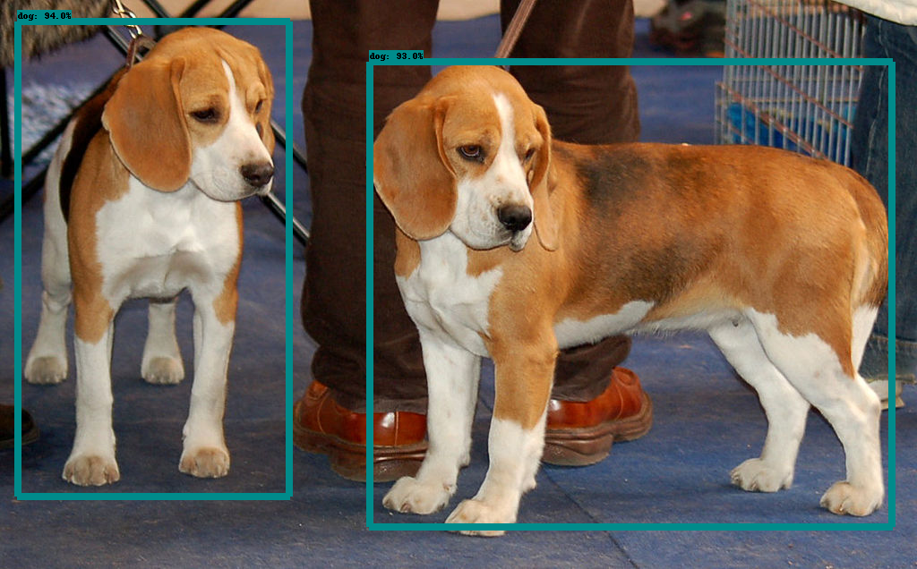
III、Detection
#for image_path in TEST_IMAGE_PATHS:
show_inference(detection_model, image_path)

Slide 14
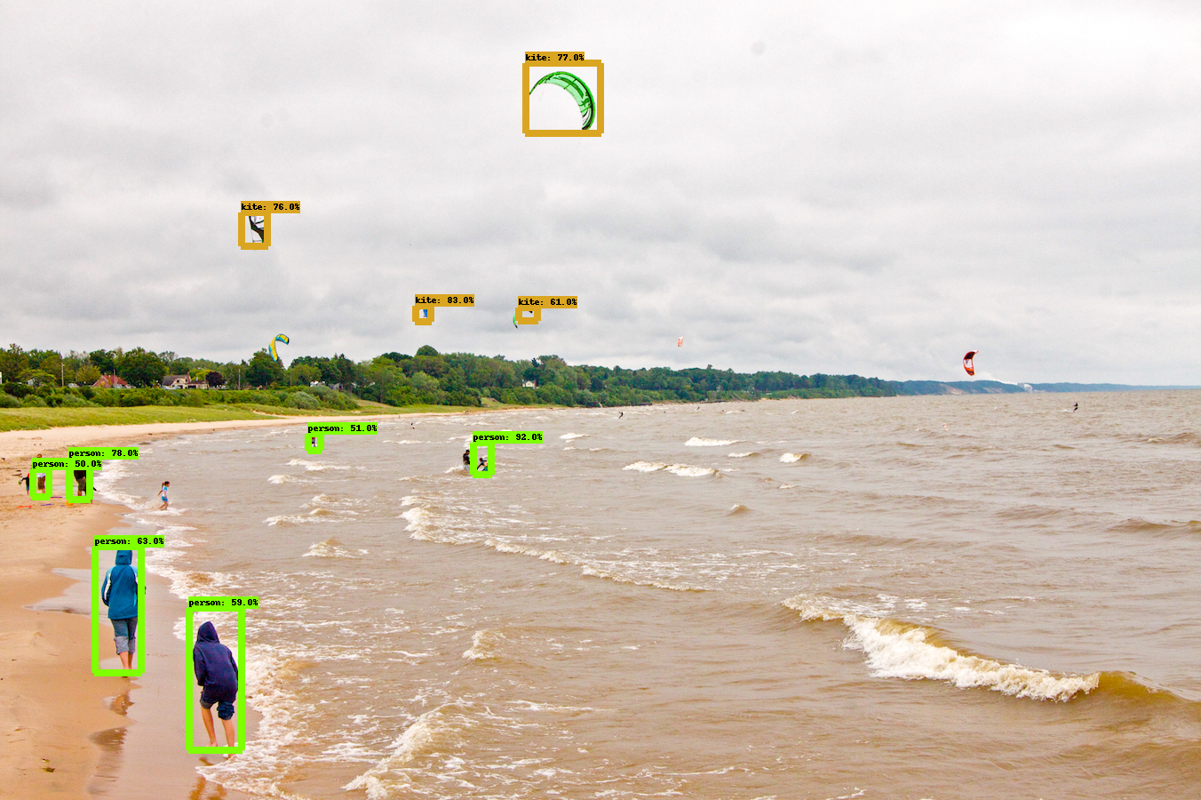
III、Detection

Slide 15
IV、Instance Segmentation
model_name = "mask_rcnn_inception_resnet_v2_atrous_coco_2018_01_28"
masking_model = load_model(model_name)
Downloading data from http://download.tensorflow.org/models/object_detection/mask_rcnn_inception_resnet_v2_atrous_coco_2018_01_28.tar.gz
727392256/727390102 [==============================] - 14s 0us/step INFO:tensorflow:Saver not created because there are no variables in the graph to restore

Slide 16
IV、Instance Segmentation
實例細分模型包括detection_masks輸出
masking_model.output_shapes
{'detection_boxes': TensorShape([None, 100, 4]),
'detection_classes': TensorShape([None, 100]),
'detection_masks': TensorShape([None, None, None, None]),
'detection_scores': TensorShape([None, 100]),
'num_detections': TensorShape([None])}

Slide 17
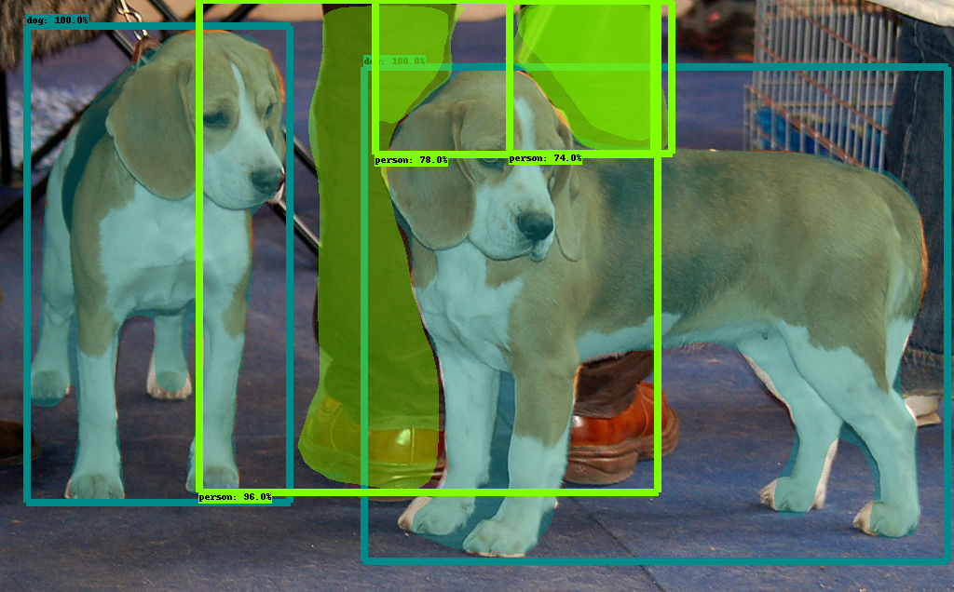
IV、Instance Segmentation
for image_path in TEST_IMAGE_PATHS:
show_inference(masking_model, image_path)

Slide 18
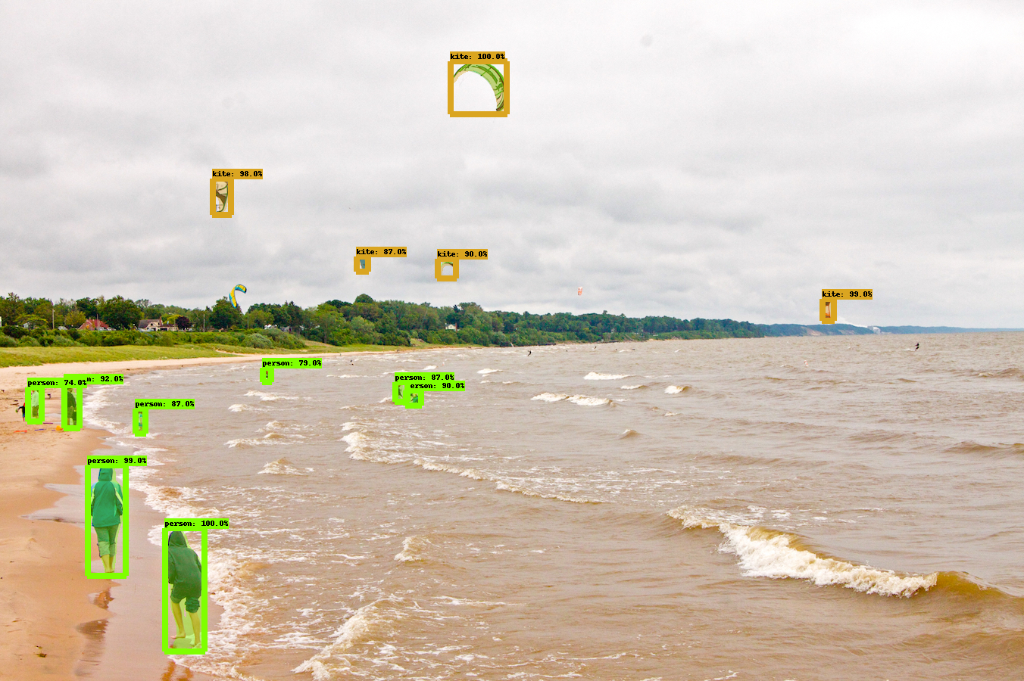
IV、Instance Segmentation
for image_path in TEST_IMAGE_PATHS:
show_inference(masking_model, image_path)

Slide 19
參考文獻

Slide 20
https://github.com/tensorflow/models/tree/master/research/object_detection
https://medium.com/@9821343/object-detection-api%E7%89%A9%E4%BB%B6%E8%AD%98%E5%88%A5%E5%88%86%E9%A1%9E%E5%99%A8%E5%AF%A6%E4%BD%9C-%E6%8E%A1%E7%94%A8tensorflow-cpu-%E5%9C%A8windows-10%E4%B8%8A-83d73065f27f
https://blog.gtwang.org/programming/tensorflow-object-detection-api-tutorial/

Slide 21
謝謝聆聽

